Slide 1
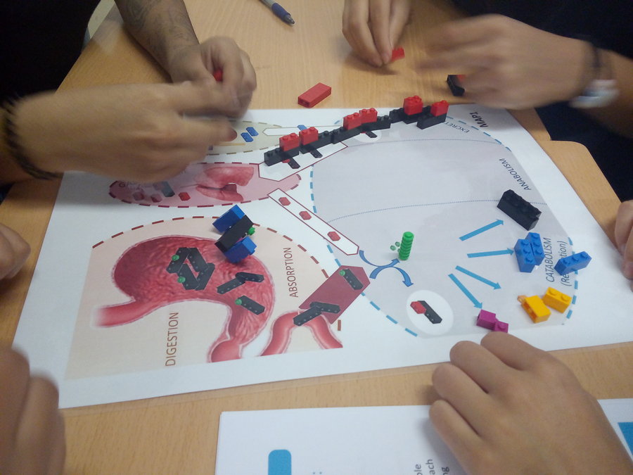
LIFE BRICKS 2.1
Students’ Guide
Life is a dynamic process where energy and matter make possible very particular chemical structures: the living beings. This is a complex process of transformation molecules to get energy, to build or regenerate parts of our body. During several steps you will take care of a Cell and try to keep your cell alive. You will discover that life is not easy. But it’s creative!
Students ‘names
This card is part of the materials of the activity “LifeBricks” Materials of the activity and Didactic Guides are available for its download at: https://bit.ly/2ZksPOp

Slide 2
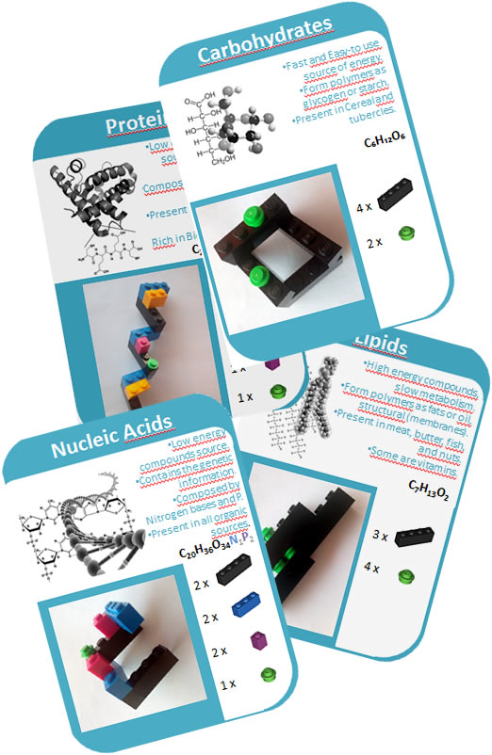
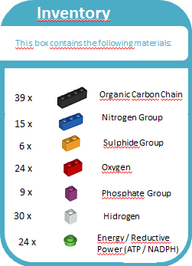
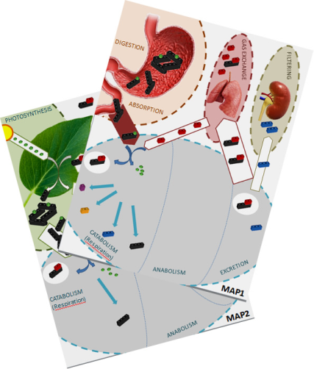
Module 0: Explore the materials
LIFE BRICKS
1. Observe the materials inside the box and the represented types of basic pieces (Inventory card) and organic biomolecules (Carbohydrate, Lipid, Protein, Nucleic Acid).
2. Observe the Maps Map1 and Map2 and discuss the terms (Catabolism, Anabolism, Photosynthesis...).
This card is part of the materials of the activity “LifeBricks” Materials of the activity and Didactic Guides are available for its download at: https://bit.ly/2ZksPOp

Slide 3
Module 1: Catabolism and Anabolism (I): Homeostasis
LIFE BRICKS
Use Map 1. Analyse its compartments and elements and discuss about its meaning. Build one organic biomolecule of each type (Carbohydrate, Lipid, Protein, Nucleic Acid). Get some Oxygen pieces on the Map and close the box.
Ingestion: put the Biomolecules on the Map 1 digestive tract and initiate partial digestion (disassemble Carbon Chains one from another, but not other pieces).
This smaller Digested Biomolecules can be absorbed and distributed (through blood system) to the Cells. Inside the cells, Catabolism initiates as Respiration with total digestion of the biomolecules. Disassemble (Catabolism) the molecules to its units. Take into account that each “Energy” piece you set free has to be substituted on the corresponding Carbon piece by an Oxygen piece (this is called Cell Respiration).
Carbon Chain + Oxygen → OxidizedCarbonChain + energy + H₂O
3. Try now to build (Anabolism) at least 2 organic biomolecules. You cannot use Oxidized Carbon Chains (CO₂) for Anabolism. You can “rescue” Oxidized Carbon Chains (CO₂ ) by quenching its Oxygen by a free Energy piece (losing an Energy piece).
4. Which is the result? What happened with Carbon Chains? What about Energy? What will happen with units that are not used to construct new biomolecules?
5. Try now to do again the process. Do not add new biomolecules to the cell. Work only with those contained inside. What happens now? Explain your results using the concepts Anabolism, Catabolism, Cell Respiration.
If you success: 3 life points
This card is part of the materials of the activity “LifeBricks” Materials of the activity and Didactic Guides are available for its download at: https://bit.ly/2ZksPOp

Slide 4
Module 1: Catabolism and Anabolism (I): Homeostasis
LIFE BRICKS
What we did...
What happened...
What it means....
Key ideas:
All living organisms are build by similar chemical “pieces” (biomolecules).
Different biomolecules are formed by different ratios of essential bioelements.
Obtaining energy by respiration from organic biomolecules generates a loss of carbon chains as oxidized Carbon.
This card is part of the materials of the activity “LifeBricks” Materials of the activity and Didactic Guides are available for its download at: https://bit.ly/2ZksPOp

Slide 5
Module 2: Catabolism and Anabolism (II): Cell Specificity
LIFE BRICKS
Now you will try to get different kinds of cells alive. Take into account the following survival conditions (regardless ot the Cell type): a minimal energy (6 U) and maximal Oxidized Carbon Chains (CO₂ = 16 U) units per cell and an amount of free N between 8 and 12 U) Cells not getting this conditions will Die.
Build 3 molecules of each type (3 Carbohydrate, 3 Lipid, 3 Protein, 3 Nucleic Acid).
Select which kind of cell your team is:
  Muscle Cell: you have to synthesize 2 Carbohydrates and 3 Proteins available for muscle contraction.
  Epithelial Cell: you have to synthesize 3 Proteins and 3 Nucleic Acids available for cell division.
  Adipocyte: you have to stock energy as 6 Lipids.
  Nerve cells: you must synthesize 3 Carbohydrates and 2 Lipids to synthesize neurotransmissors.
Round 1 (Breakfast): Ingest 1 biomolecule of each (1 Carbohydrate, 1 Lipid, 1 Protein, 1 Nucleic Acid) and Perform a Catabolism-Anabolism Cycle taking into account your cell-type requirements.
Round 2 (Lunch) : Ingest 1 more biomolecule of each and perform second Catabolism-Anabolism Cycle taking into account your cell requirements. You can use remaining metabolites from the first cycle.
Round 3 (Dinner): Ingest 1 more biomolecule of each and repeat step 4.
Observe the content of your cell and compare it with your other classmates that have different cell types. Take a look at the metabolites in each case: are they different? Why? What would happen if Cells were allowed to exchange Biomolecules or Bioelements after each Round?
If you success: get 3 life points. If not: lose 2 life points
This card is part of the materials of the activity “LifeBricks” Materials of the activity and Didactic Guides are available for its download at: https://bit.ly/2ZksPOp

Slide 6
Module 2: Catabolism and Anabolism (II): Cell Specificity
LIFE BRICKS
What we did...
What happened...
What it means....
Key ideas:
Some bioelements are essential but can be toxic when excessive levels.
Cells having different funtions have different metabolic needs.
Cells exchange biomolecules and bioelements with other Cells and the media to get their metabolic needs.
This card is part of the materials of the activity “LifeBricks” Materials of the activity and Didactic Guides are available for its download at: https://bit.ly/2ZksPOp

Slide 7
Module 3: Catabolism and Anabolism (III): Diet
LIFE BRICKS
In this module, all the teams will be again “standard” cells, so needing to synthesize equilibrated amounts of each Biomolecule kinds. As you will be following special demands, work together with another team, putting in common the pieces form your boxes.
Each team will follow a different diet, so for each Ingestion, biomolecules will be the following:
  Ultracaloric Diet: 2 Carbohydrates , 2 Lipid.
  Ultraproteic/Paleo Diet. 2 Carbohydrate, 2 Proteins.
  Low-Energy Diet: 2 Protein, 2 Nucleic Acid.
  “Depurative” Diet: 2 Nucleic Acid, 2 Carbohydrate.
Make 3 Ingestions (Breakfast, Lunch, Dinner) trying to Keep the survival conditions and synthesizing the 4 different kinds of biomolecules. Survival Conditions: a minimal energy (6 U) and maximal Oxidized Carbon Chains (CO₂ = 16 U) units per cell and an amount of free N between 8 and 12 U) (regardless ot the Cell type). Cells not getting this conditions will Die.
Observe the content of your cell and compare it with your other classmates that have different cell types. Take a look at the metabolites in each case: are they different? Why? Are there dead cells? Why? If all of the cells have the same diet, would the problem be solved as in the previous step, exchanging bioelements or molecules? Why?
Which cell kinds from Module 2 would suffer the more each of these diets? Which are the expectable diseases?
If you success: get 2 life points. If not: lose 3 life points
.
This card is part of the materials of the activity “LifeBricks” Materials of the activity and Didactic Guides are available for its download at: https://bit.ly/2ZksPOp

Slide 8
Module 3: Catabolism and Anabolism (III): Diet
LIFE BRICKS
What we did...
What happened...
What it means....
Key ideas:
Diets have to take into account not only energy and Carbon Chains, but also bioelements.
Chronical lack, but also chronical excess of biomolecules or bioelements, put it difficult for cells to survive or work properly.
Some cells will be affected before others when diet limitations.
This card is part of the materials of the activity “LifeBricks” Materials of the activity and Didactic Guides are available for its download at: https://bit.ly/2ZksPOp

Slide 9
Module 4: Respiration and Photosynthesis
LIFE BRICKS
(in this Module, use Map 2). You are now a Vegetal Cell. You are not Ingesting, so as a first Step, you have to make Photosynthesis.
Using sunlight as a source of energy to build basic organic carbon chains. In the chloroplast (Photosynthesis zone) absorb 4 molecules of Carbon dioxide (coming from atmosphere) and recover 8 Energy pieces (coming from the sun) to build 4 Carbohydrates. Release excess Oxigen.
Transport the Carbon Chains you synthesized to the Cytoplasm. Try to synthesize Lipids. You cannot pass free Energy Units from Chloroplast to Cytoplasm, only Carbon Chains with one Energy Unit on each.
Try now to use biomolecules to synthesize Proteins and nucleic acids. What happens?
Essential Bioelements as S, N, P, are not obtained from atmosphere, but from roots. Take pieces of each bioelement (S,P, N) and try to synthesize one biomolecule of each type (Carbohydrate, Lipid, Protein, Nucleic Acid). Redo steps 1 and 2 as much as you need. If you don’t get to it, or exceed the survival conditions, your cell will die.
Which are the results? What happened with Carbon Dioxyde? Which is the global balance in Oxygen and Carbon Dioxyde? Why? What about energy? Where are Carbon chains and Energy coming from?
Now it’s Night and no Energy units from light are getting in the Chloroplast. Try to do your best to get more energy in the cytoplasm.
What happens now? Why? Is this similar to the reaction on Step 1?
What will happen with plants growing on low-N soils?
Explain your results from questions 7 and 8 using the concepts Autotroph, Heterotroph, Anabolism, Catabolism, Oxidative Respiration, Photosynthesis.
OxidizedCarbonChain + energy + H₂O → Carbon Chain + Oxygen
If you success: get 1 life points. If not: lose 4 life points
This card is part of the materials of the activity “LifeBricks” Materials of the activity and Didactic Guides are available for its download at: https://bit.ly/2ZksPOp

Slide 10
Module 4: Respiration and Photosynthesis
LIFE BRICKS
What we did...
What happened...
What it means....
Key ideas:
Plants are the Ecosystem converters of Inorganic Carbon into Organic carbon chains.
Plants don’t get energy from the Sunlight, they get energy from the biomolecules they build with energy Sunlight.
Roots collects essential bioelements to build different kinds of biomolecules.
This card is part of the materials of the activity “LifeBricks” Materials of the activity and Didactic Guides are available for its download at: https://bit.ly/2ZksPOp

